Slide 1

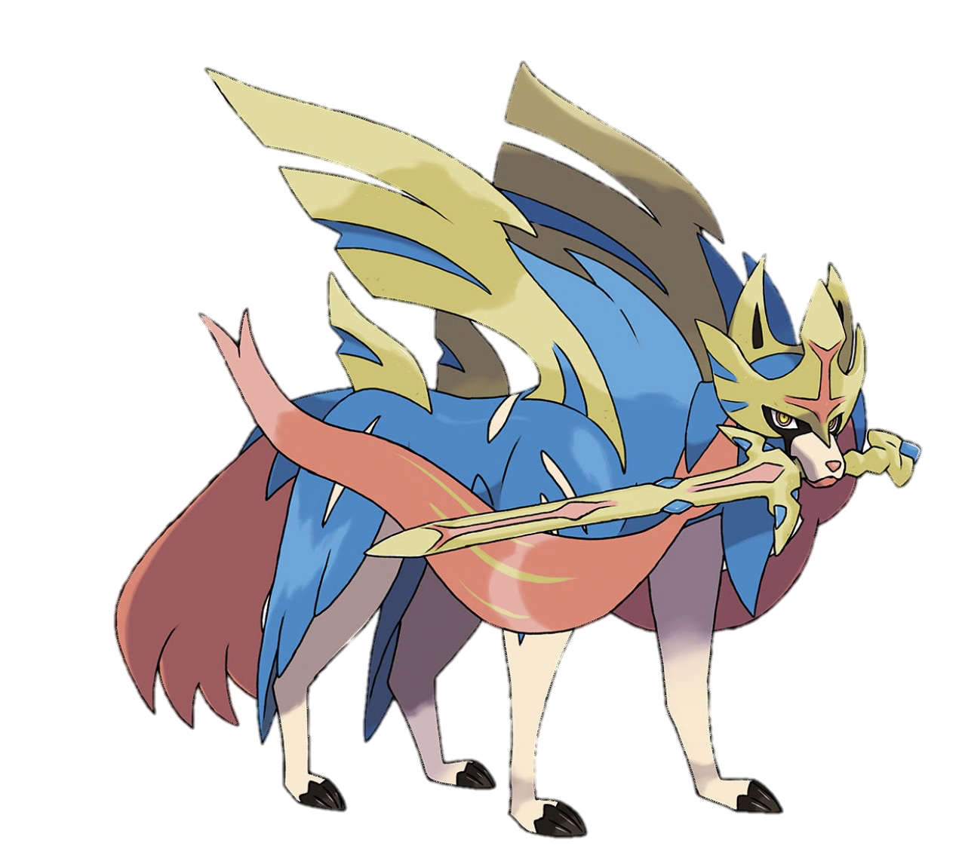

Sword & Shield
Topic modelling game reviews
Notes:
Hi, I’m Adeline and my project is about topic modelling Pokémon Sword and Shield game reviews.

Slide 2
The Switch Franchise
6.15
4.00
Notes:
However, players don’t seem to think so. From Metacritic reviews, the game is bad, averaging a 4 out of 10, versus a mixed score that the Let’s Go series received.
Why are players so upset? That’s what my project aims to answer. With a better sense of what players are upset about, Game Freak, the game developer can better deal with the backlash and perhaps, make a better game in future.

Slide 3
Chapters
1
Collection
2
Cleaning
3
Models
nltk
spaCy
4
Topics
scikit-learn
gensim
5
Conclusion
BeautifulSoup
pandas
wordcloud
matplotlib
Notes:
Let’s begin our journey! I’ll be taking you through my data collection and cleaning processes. How I chose an appropriate model, and the topics found before concluding.
I also have my team of Pokémon to thank for helping me through the battles.

Slide 4
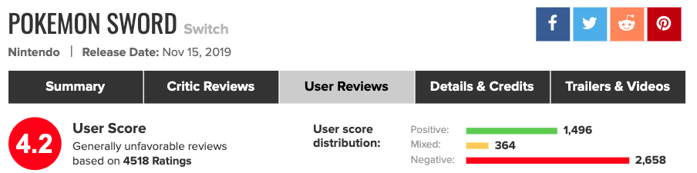
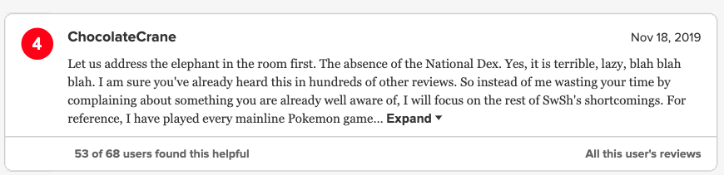
Notes:
3.2k Pokémon Sword and Shield reviews were scrapped from Metacritic over a two-week period since the game’s launch date.
Majority of the reviews were negative.
Following Metacritic’s rating system, a score of less than 5 would be considered negative, 5 to 7 mixed and 8 and above positive.

Slide 5
Cleaning Moves List
Remove
Others
Non-English reviews
Words with < 3 char
Stop words
Rare words
Common words
Punctuation
Digits
Other special char
Lemmatization
(NOUN & VERB)
2-grams
Notes:
Having filtered for the negative reviews, I cleaned the data by using removing non-English reviews, I also removed, short words that had less than 3 characters, stop words, rare words that appeared in less than 3 documents, common words that appeared in almost all documents. Digits, punctuations, and other special characters were also removed.
Following this, I also lemmatized the words using Spacy, and kept only nouns and verbs. This was to help obtain clearer topics. Moreover, bigrams were also applied to the model.

Slide 6
Models
LSA
NMF
gensim LDA
Mallet LDA
Notes:
What your Eevee evolves into depends on what evolution stone you use on it. Same thing with data and models.
Latent semantic analysis, Non-negative matric vectorization, Latent Dirichlet Allocation
I applied 3 different models on the negative Pokémon reviews. LSA and NMF resulted in topics that were not as distinct as the LDA models.
The choice was between genism’s default LDA, and Mallet LDA. The main different between the two LDA models is the sampling method.

Slide 7
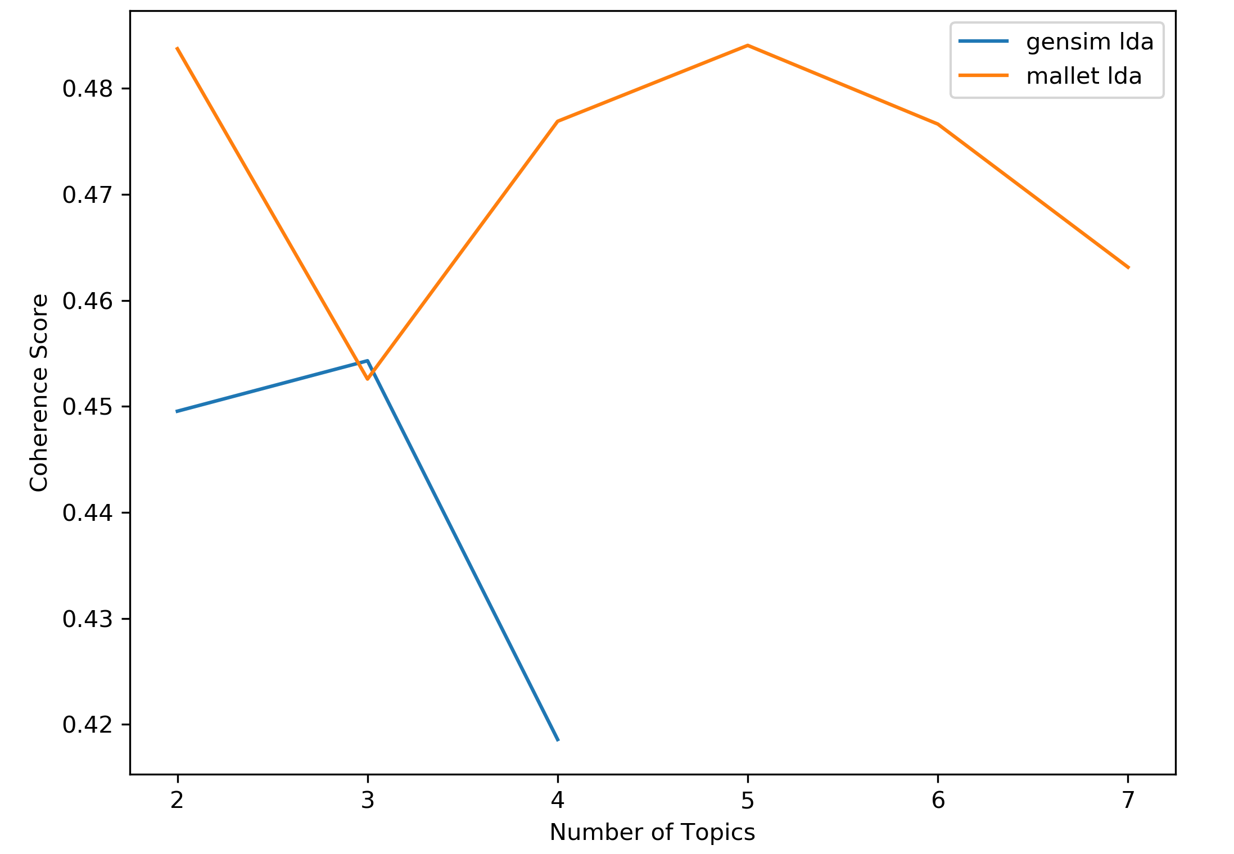
Coherence Scores
Notes:
To choose between the two LDA models, and determine the number of topics, I used coherence score as a metrics. Coherence scores assess the quality of the topics by examining the degree of semantic similarity between each topic’s top words. The higher the coherence score, the better.
Looking at the graph, it appears that mallet LDA outperforms gensim, and the optimal number of topics is 5.

Slide 8

Mallet LDA Topics
TIME
VISUALS
DEVELOPER
EXPERIENCE
play, thing, story, time, lot, hour gameplay, work, people, catch
feel, area, battle, design, character, gym, story, level, team, route
animation, cut, model, remove, graphic, world, turn, texture, quality, feature
CONTENT
content, feature, switch, console, series, franchise, experience, generation, shield, lack
gamefreak, fan, graphic, buy, lie, money, year, release, cut, rush
Notes:
In terms of experience, players felt that the story was lacking, and overall game play was too easy. Moreover, the much hyped up wild area was poorly animated, and mostly empty.
Another gripe was the lack of content in the switch game. Players often compared the switch games to the 3DS games, which had a lot more features, and content. If you look at the word map, cut comes up quite prominently. One of the reasons is because of a large number of Pokémon were cut out from Sword and Shield.
So it’s no wonder that they felt that play time was way to short. Many players completed the game in 10 to 25 hours.
On the visuals, many of the players felt that the animation, graphics, models lacked quality and texture. Expectations were sky high on the visuals part because Game Freak cited this as the reason for cutting out so many Pokémon from the game.
You can also see that new Pokémon models were not made, and were reused from the 3DS.
And because Game Freak did not deliver on their promise of stunning visuals, many players felt betrayed by the developer.
They felt Game Freak lied to them, and that the cut in Pokémon was not justified given the state of the visuals.

Slide 9
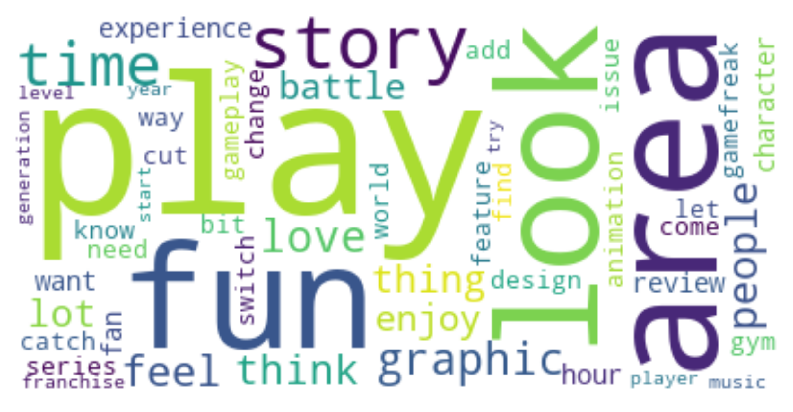
Positive Reviews
Notes:
Interestingly, when I repeated the same steps on positive reviews, there were only two main topics, positive feelings about the game, and how they enjoyed the game.

Slide 10
Different types of fans?
Notes:
The same words seem to be popping up for positive and negative reviews.
Perhaps it is the case of long time Pokémon fans who are used to the older games, versus newer players who started playing Pokemon on the switch? Or it could be the case of casual gamers enjoying the simplicity of the game, versus more seasoned gamers who expect more.
Looking into player characteristics would be fruitful for future work.
In the meantime, GameFreak should work on rebuilding trust in their brand, and update the games with good postgame content as a peace offering to its fans.

Slide 11



Thanks!
https://medium.com/@adelweiss
https://www.linkedin.com/in/adeline-ong-a66828161/
https://github.com/adelweiss

